Slide 1
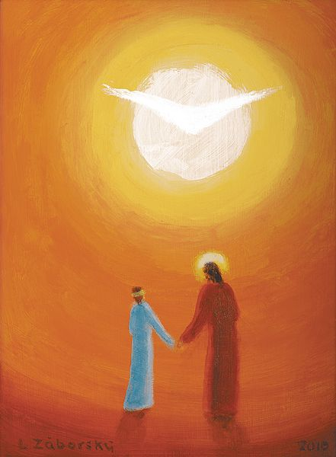
‘Follow Me’
WEEKLY PEBBLE
22nd Sunday of Ordinary Time

Slide 2
In the name of the Father
And of the Son
And of the Holy Spirit
Amen

Slide 3
A reading
from
THE GOSPEL
According to
MATTHEW

Slide 4
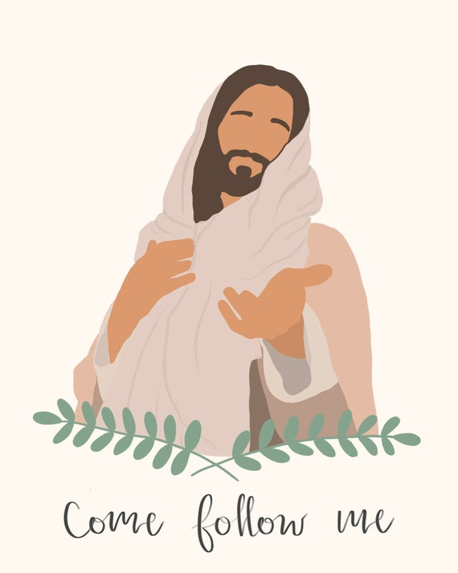
Jesus said ‘If anyone wants to be a follower of mine, let him renounce himself and take up his cross and follow me. For anyone who wants to save his life will lose it; but anyone who loses his life for my sake will find it.’
Matthew 16:21-27

Slide 5
The Gospel of the Lord
ALL: Praise to you Lord Jesus Christ.

Slide 6
Scripture Sound Bite
‘Follow me.’
Matthew 16:21-27
Each of us is on a learning journey to discover how to live life to the full.
Jesus’ example and teachings help to provide us with guidance and reassurance to keep us on the right path.
As we start a new year together, what are the first steps that you’ll take to enable you to live life to the full?

Slide 7
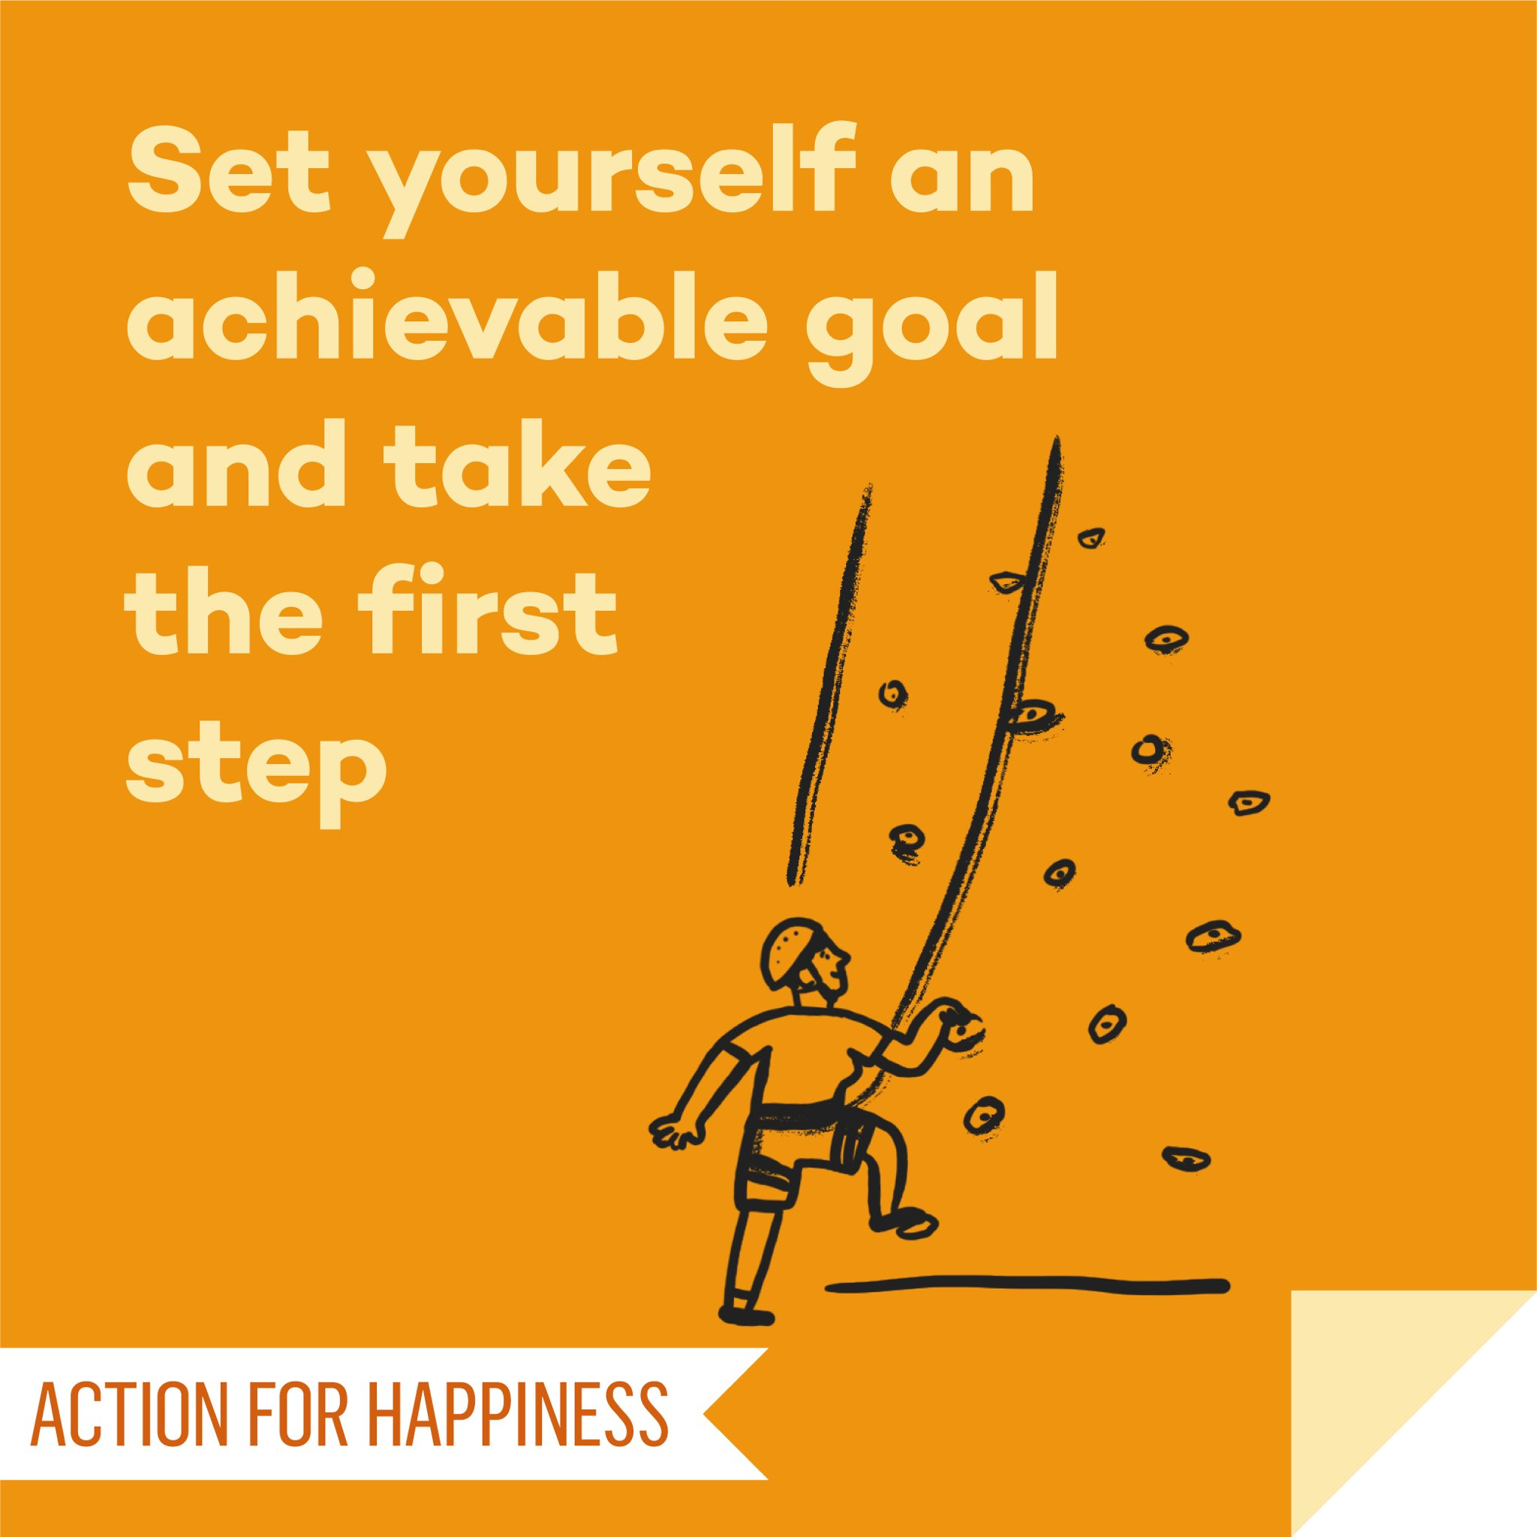
Actions for Happiness: Direction
Have goals to look forward to
How we feel and think about the future and how we work towards it can make a difference for our happiness in the present.
A journey of a thousand miles begins with a single step. Chinese Proverb

Slide 8
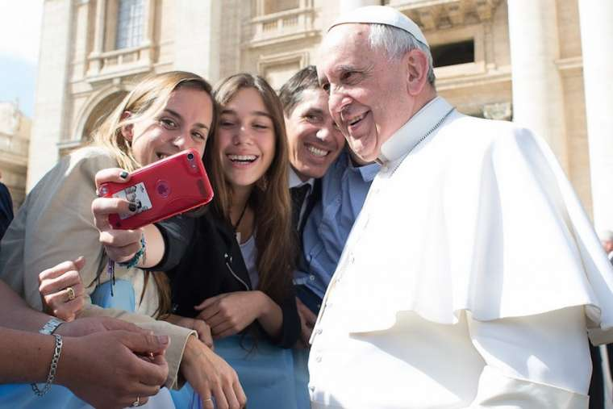
“
Dear young people.
Do not bury your talents, the gifts that God has given you.
Do not be afraid to dream of great things
Pope Francis
“

Slide 9
Dear Jesus
Thank you for this new school year and all the potential it holds. Let your gifts of love, hope, joy and forgiveness
help us to learn how to live life to the full.
Amen
PRAYER
Notes:
Gospel
John 14:15-21

Slide 10
In the name of the Father
And of the Son
And of the Holy Spirit
Amen

Slide 11
GREAT DREAM: 10 Keys to Happier Living
 | GIVING Do things for others |  | DIRECTION Have goals to look forward to
 | RELATING Connect with people |  | RESILIENCE Find ways to bounce back
 | EXERCISING Take care of your body |  | EMOTION Look for what’s good
 | AWARENESS Live life mindfully |  | ACCEPTANCE Be comfortable with who you are
 | TRYING OUT Keep learning new things |  | MEANING Be part of something bigger
BE KIND TO YOUR MIND

Slide 12
WEEKLY PEBBLE is based on the theme of each Sunday’s Gospel.
It can be used to inspire personal reflection or collective worship.
The slides are designed to make them easy to adapt for children of any age and adults.
Each pebble includes free wellbeing activities based on ideas from actionforhappiness.org.
For more prayer activities and training resources on Catholic ethos
visit https://www.stjohnthebaptist-cmat.org.uk/chaplaincy
or contact our Lay Chaplain Alex Savage
Email: chaplaincy@ndhs.org.uk Twitter: @ndhs_chaplain
WEEKLY PEBBLE
St John the Baptist Trust

