Slide 1
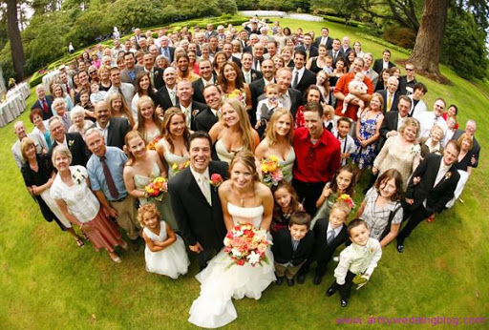
Everyone is invited
WEEKLY PEBBLE
28th Sunday of Ordinary Time

Slide 2
In the name of the Father
And of the Son
And of the Holy Spirit
Amen

Slide 3
A reading
from
THE GOSPEL
According to
MATTHEW

Slide 4
A king gave a feast for his son’s wedding. However, none of the people he invited came.
He said to his servants ‘go and invite everyone you can find.
So the servants collected together everyone they could find, good and bad alike and filled the hall.
Adapted from Matthew 21:1-10

Slide 5
The Gospel of the Lord
ALL: Praise to you Lord Jesus Christ.

Slide 6
Scripture Sound Bite
‘invite everyone you can find’
Matthew 21:1-10
The word ‘Catholic’ comes from two Greek words ‘Kata’ and ‘Holos’ which mean ‘including everyone’.
Jesus’ teachings are universal. The Gospel values of love, hope, joy, peace and forgiveness touch the lives of all humans.
We are all invited to the party and will receive a warm welcome.

Slide 7
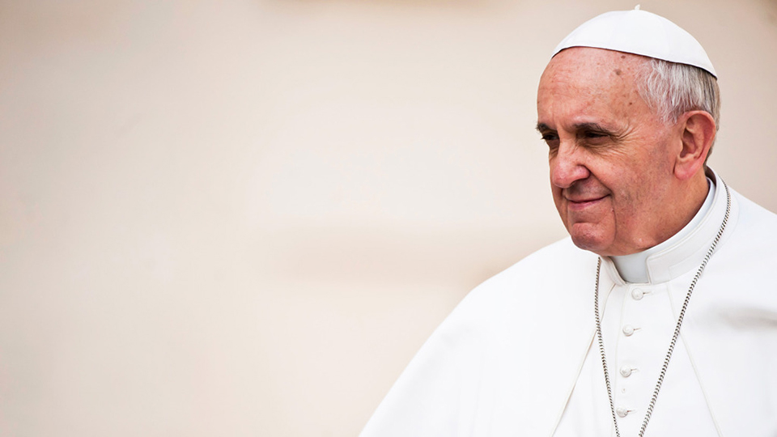
‘The Church is the house where everyone is welcomed and no one is rejected.’
POPE FRANCIS

Slide 8
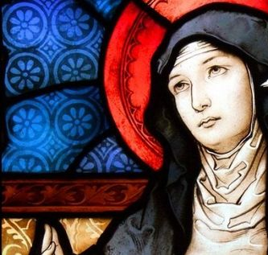
Christ has no body here on earth but yours.
No hands but yours,
No feet but yours;
Yours are the eyes through which Christ looks out his compassion to the world,
Yours are the feet with which he is to go about doing good,
And yours are the hands with which he is to bless us now.
St. Teresa of Avila
Feast Day: 15/10
Notes:
Lord, make me an instrument of Your peace.
Where there is hatred, let me sow love;
where there is injury, pardon;
where there is doubt, faith;
where there is despair, hope;
where there is darkness, light;
where there is sadness, joy.

Slide 10
God of solidarity
When the word became flesh
You came and stood side by side with all your people
In the midst of their suffering and pain
May we hear your call to stand in solidarity
With all of our sisters and brothers
And let our faith guide us to become one community.

Slide 11
In the name of the Father
And of the Son
And of the Holy Spirit
Amen

Slide 12
GREAT DREAM: 10 Keys to Happier Living
 | GIVING Do things for others |  | DIRECTION Have goals to look forward to
 | RELATING Connect with people |  | RESILIENCE Find ways to bounce back
 | EXERCISING Take care of your body |  | EMOTION Look for what’s good
 | AWARENESS Live life mindfully |  | ACCEPTANCE Be comfortable with who you are
 | TRYING OUT Keep learning new things |  | MEANING Be part of something bigger
BE KIND TO YOUR MIND

Slide 13
WEEKLY PEBBLE is based on the theme of each Sunday’s Gospel.
It can be used to inspire personal reflection or collective worship.
The slides are designed to make them easy to adapt for children of any age and adults.
Each pebble includes free wellbeing activities based on ideas from actionforhappiness.org.
For more prayer activities and training resources on Catholic ethos
visit https://www.stjohnthebaptist-cmat.org.uk/chaplaincy
or contact our Lay Chaplain Alex Savage
Email: chaplaincy@ndhs.org.uk Twitter: @ndhs_chaplain
WEEKLY PEBBLE
St John the Baptist Trust

