Slide 1
A Simple Guide to the Sacrament of Reconciliation
“Forgive us our trespasses
as we forgive those
who trespass against us”.

Slide 2
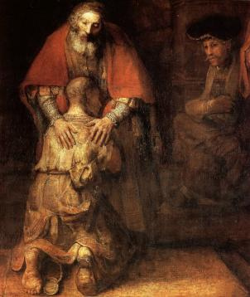

Slide 3
WHY GO TO CONFESSION?
Forgiveness is at the heart of the Gospels.
Many of Jesus’ parables were about forgiveness, such as the Prodigal Son.
Forgiveness is not about letting someone off the hook, or getting away with it. It is a healing of a hurt between two people, or between you and God.

Slide 4
Teacher: watch from 1:56

Slide 5
WHY GO TO CONFESSION?
Forgiveness is a two way process.
It has four stages:
Contrition - being truly sorry
Confession - admitting faults
Absolution - being forgiven
Penance - putting things right

Slide 6
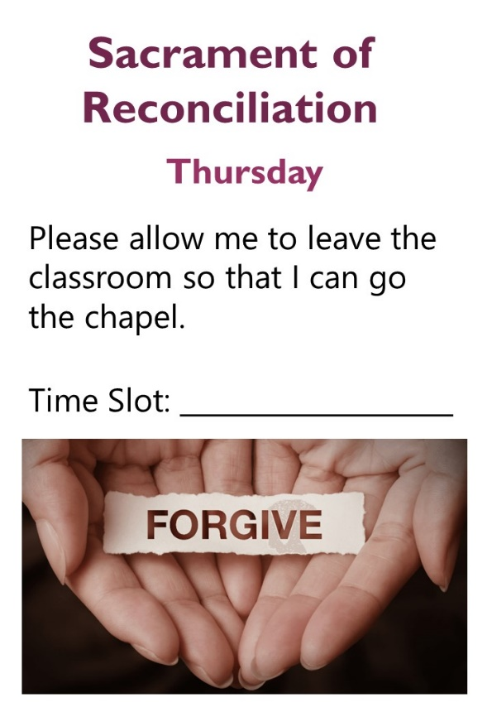
WHEN CAN I GO TO CONFESSION?
Y7 | Y8 | Y9
17/3 | 24/3 | 31/3
Your Form will be given a time slot between P.1-3 on a specific day.
You can get a permission slip from your Form Tutor.

Slide 7
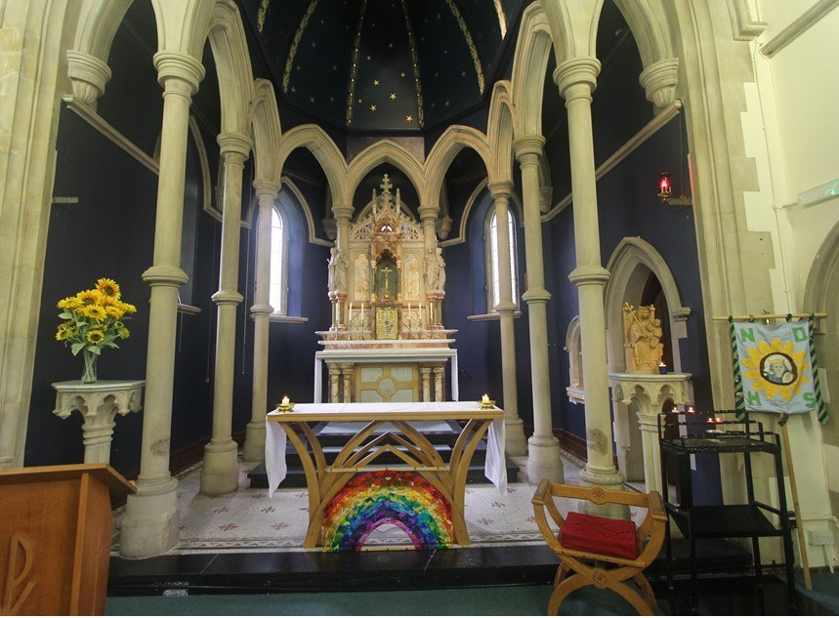
WHAT DO I DO?
At the start of the lesson, give the permission slip to your Teacher. Your Teacher will decide when you can go to the Chapel.
In the Chapel a member of staff will welcome you and help you to prepare.
Fr Sean will sit by the side of the altar to speak to each person.
There will be music playing so that you can talk in private.

Slide 8
HOW DO I PREPARE?
Before you receive the sacrament, spend some time preparing yourself in mind and heart.
Think carefully about your life and the things for which you need forgiveness.

Slide 9
HOW DO I PREPARE?
Consider the following:
Ways that I have not looked after myself
When I have not done something I was asked to do
Wrong choices that I have made
When I have been selfish
When I have lied
When I have let others down
When I have physically or verbally hurt others
When I have ignored someone that needed help
When I have not forgiven someone that upset me

Slide 10
WHAT DO I SAY?
You will be given a leaflet to help you read out all the responses and prayers that you need to say.
The priest will also help guide you on what to say and when to say it.
If it is your first confession, just let the priest know and he will help guide you.
If you prefer you can simply have a conversation with Fr Sean about anything that you wish to share with him.

Slide 11
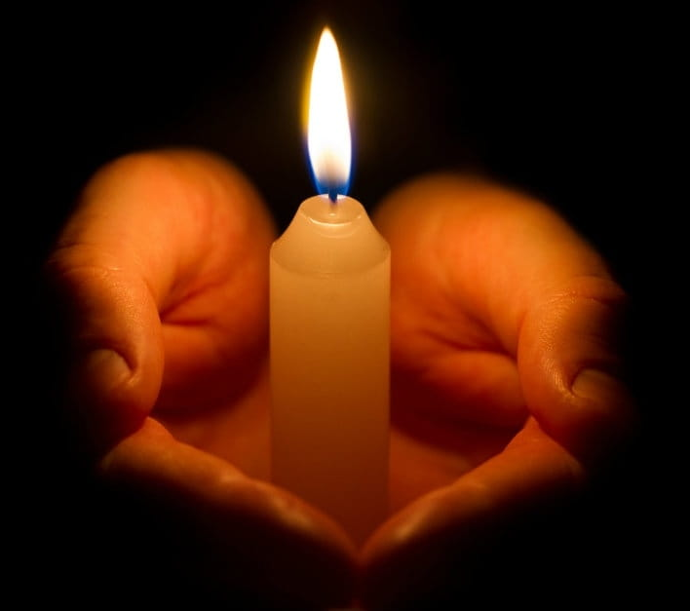
LIGHTING A CANDLE
Before leaving you can light a candle.
You may wish to say a prayer for yourself, your family and friends, or someone in particular in need of help.

